Slide 1
Development of AI driven exploration and prediction of company registration trends with registrar of companies
(PART-1)

Slide 2
DEVELOPMENT
The development of AI-driven exploration and prediction of company registration trends with the Registrar of Companies (RoC) involves leveraging artificial intelligence and data analytics to analyze patterns, extract insights, and forecast future trends in company registrations. Here's a step-by-step guide on how such a system could be developed:

Slide 3
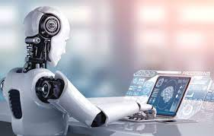
Define Objectives and Scope:
Clearly define the objectives of the AI system. What specific insights or predictions are you looking to derive from company registration data?
Define the scope of the project, including the time period and types of data you want to analyze.

Slide 4

Data Collection:
Gather historical data on company registrations from the Registrar of Companies. This may include information such as company names, types, industries, registration dates, and any other relevant details.
Ensure the data is comprehensive, accurate, and up-to-date.
Data Preprocessing:
Clean and preprocess the data to handle missing values, outliers, and inconsistencies.
Standardize and normalize data to make it suitable for analysis.

Slide 5
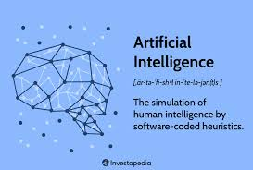
a
Feature Engineering:
Identify relevant features (variables) that can contribute to the prediction of registration trends.
Create new features or transform existing ones to enhance the predictive power of the model.
Model Selection:
Choose appropriate machine learning models for prediction. This could include regression models for numerical predictions or classification models if you're interested in predicting categories (e.g., high vs. low registration periods).
Consider using time-series models if temporal patterns are important.

Slide 6

Training the Model:
Split the data into training and testing sets.
Train the chosen model on the training data, adjusting parameters as needed.
Validate the model's performance on the testing data.

Slide 7
THANK YOU !

